Slide 1
Doing the Class 6 exercise in SPSS

Slide 2
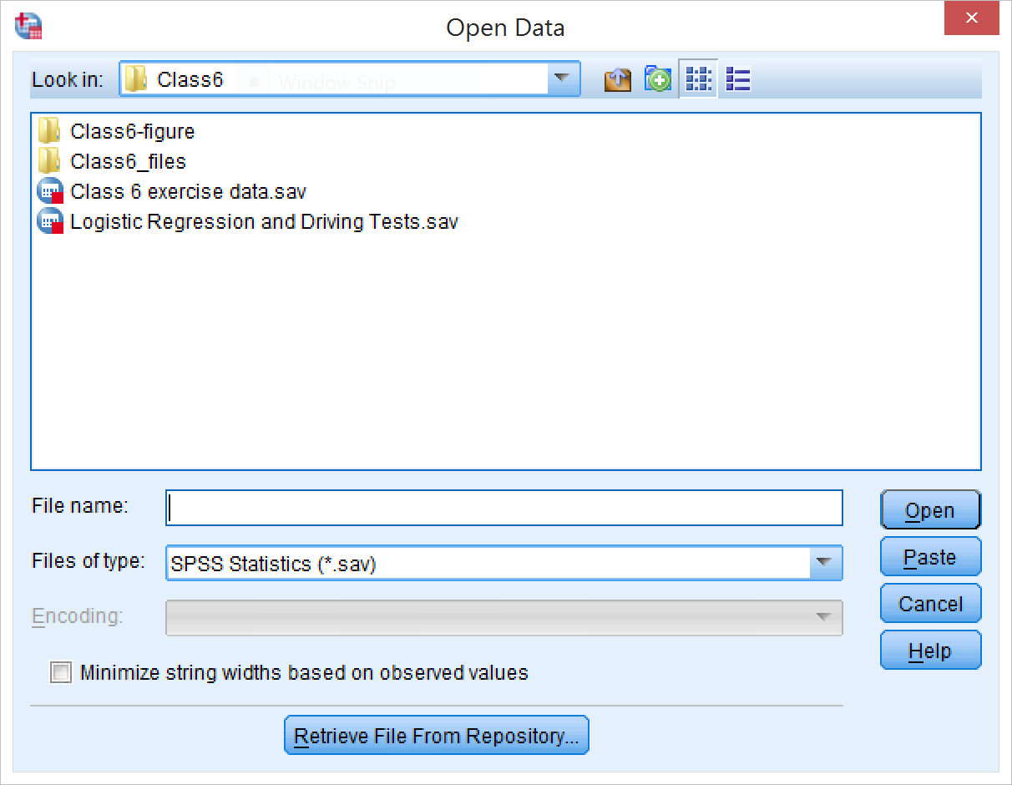
Open the data file
If you want to open the csv file directly, the instructions for that are in the “Homework 4 in SPSS” presentation on myBU.

Slide 3
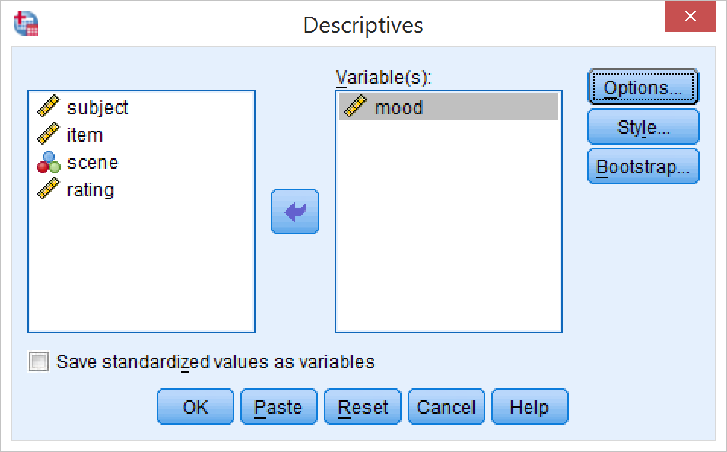
Perform the linear regression
We want to have two main effects and one interaction
First thing to do: center the mood variable
Need to know the mean first:
Analyze → Descriptive Statistics → Descriptives
Select the mood variable
Click OK

Slide 4
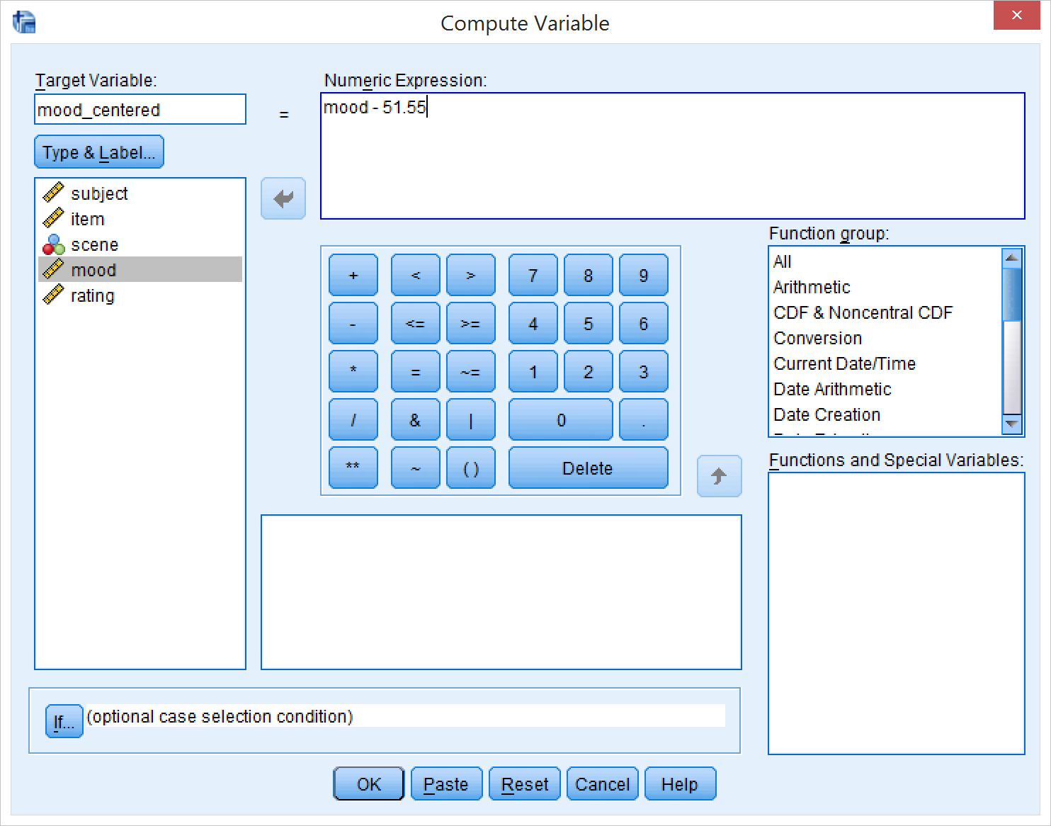
Center the mood variable
From the output we learn that the mean of the mood variable is 51.55
Now make a new variable mood_centered by subtracting the mean from each value
Transform → Compute Variable
Enter the new variable name, the formula “mood – 51.55”
Click OK

Slide 5
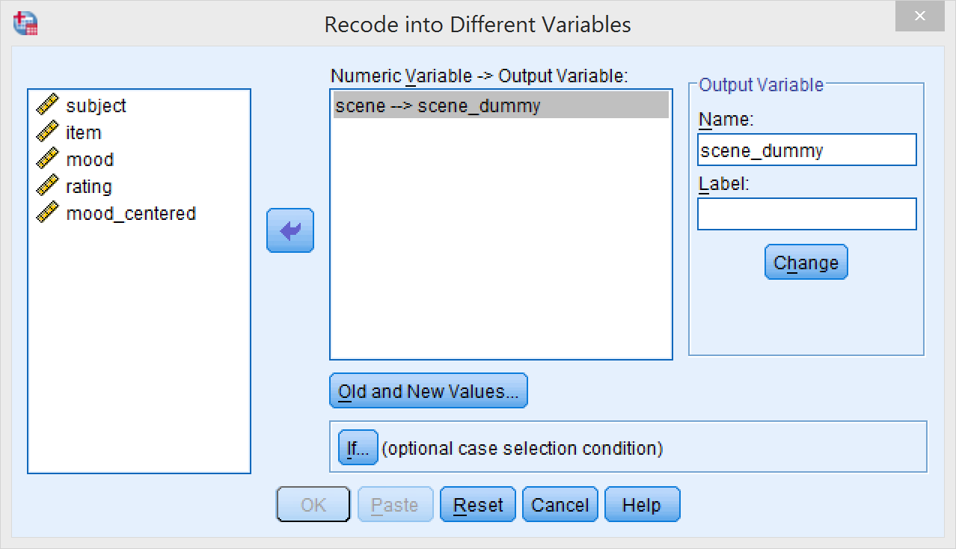
Adding the interaction term
SPSS forces you to compute the interaction term by hand if you want to add it to a regression model
To start, we need to dummy-code “scene” to make sure that the correct contrasts are used
Transform → Recode into different variables
Select “scene”
Choose a name for the output variable (“scene_dummy”)
Click Old and New Values

Slide 6
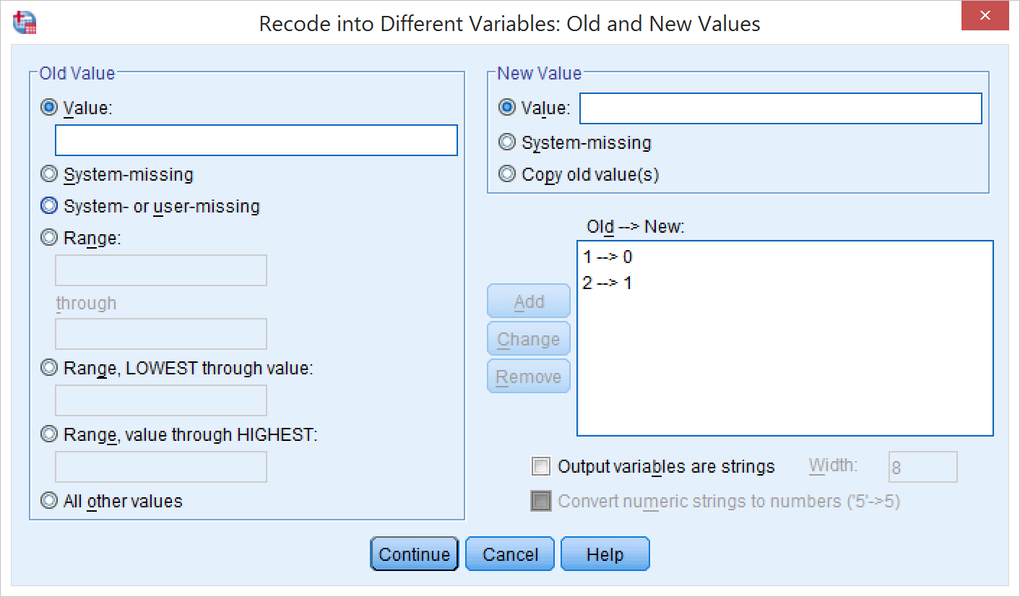
Recoding scene
Old and New Values
Replace 1 with 0 and 2 with 1 by entering each pair of numbers in “Old value” and “New value” and pressing “Add”
Click Continue
Click OK

Slide 7
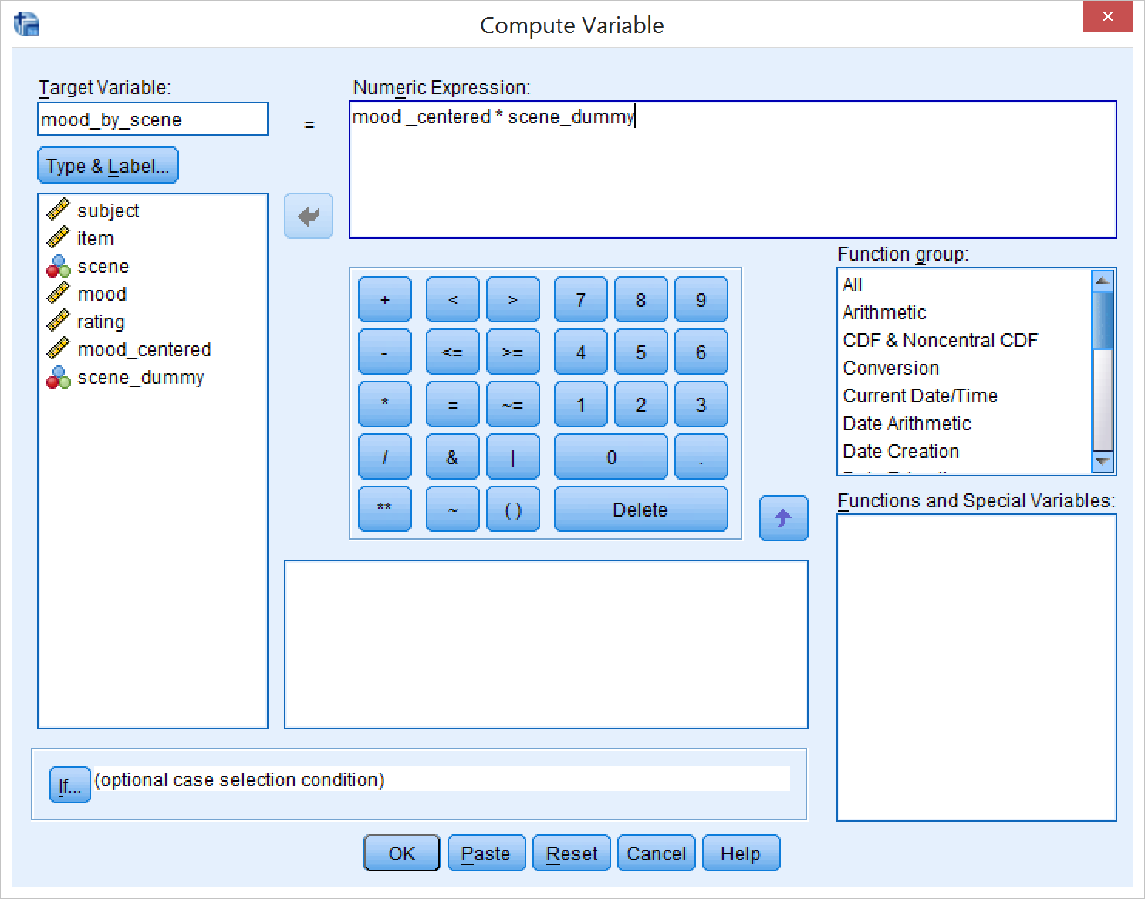
Computing the interaction term
Transform → Compute Variable
Give it a good name, e.g. mood_by_scene
Enter the formula: mood_centered * scene_dummy
Click OK

Slide 8
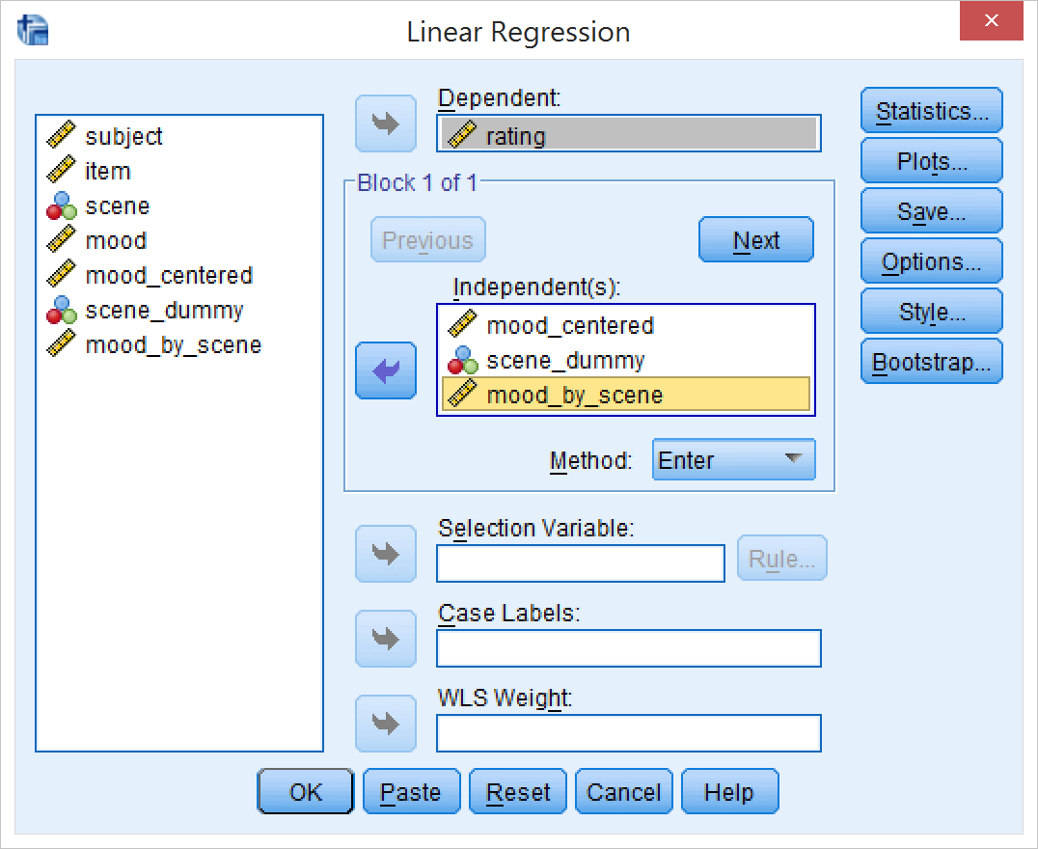
Running the regression
Analyze → Regression → Linear
Enter rating as the dependent variable
Enter the centered mood variable, the recoded scene variable, and the interaction term as independent variables

Slide 9
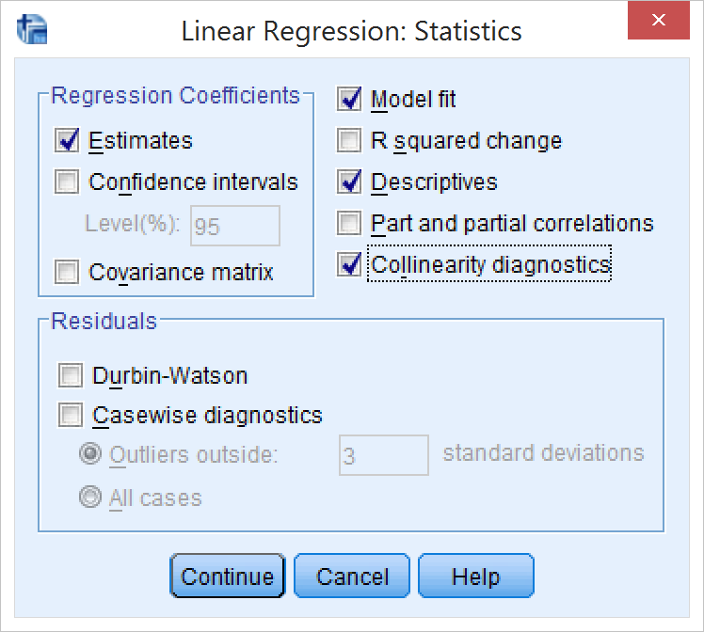
Running the regression (2)
Click Statistics…
Select Descriptives
Select Collinearity diagnostics
Click Continue

Slide 10
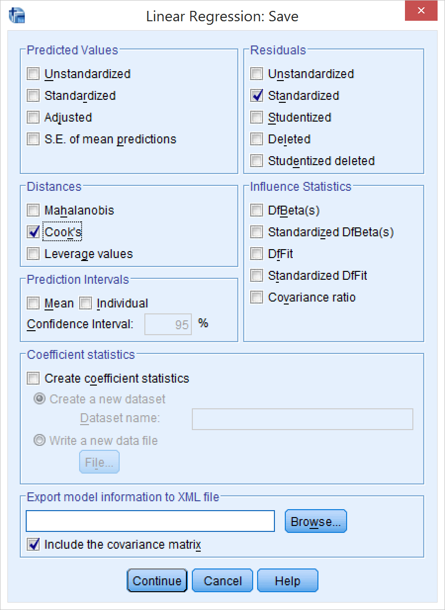
Running the regression (3)
Click Save…
Select Standardized Residuals
Select Cook’s distance
Click Continue
Click OK to run the regression

Slide 11
Regression results
Look at the output: Nothing is significant
No multicollinearity issues (max VIF = 2)

Slide 12
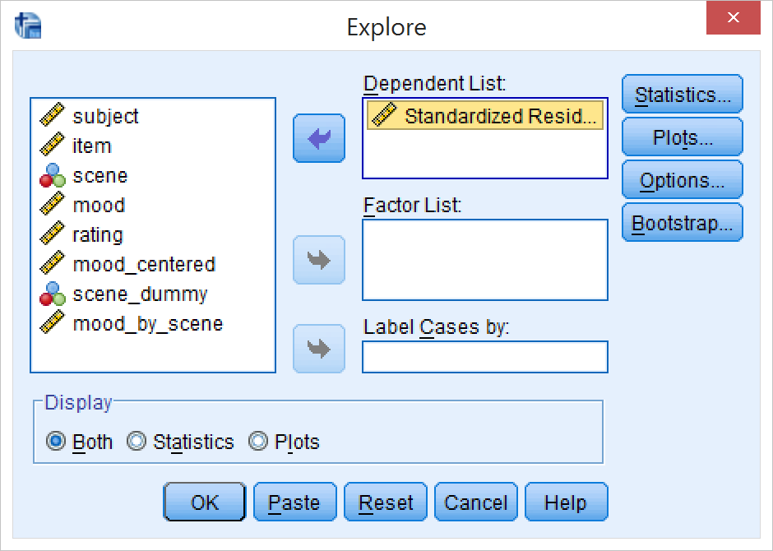
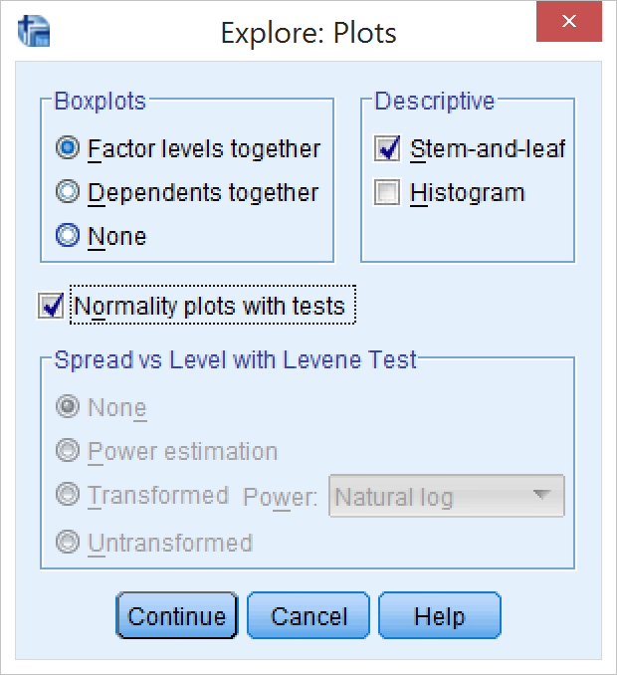
Regression results
Check normality of residuals
Analyze→Descriptives→Explore
Select the new standardized residuals variable
Click “Plots…”
Select Normality plots with tests
Click Continue
Click OK

Slide 13
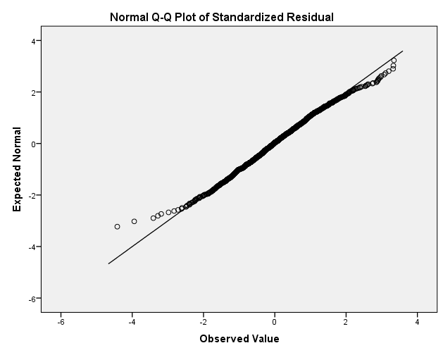
Testing normality of the residuals
Shapiro-Wilk shows a significant deviation from normality (although K-F doesn’t)
Visual inspection of the normal Quantile-Quantile plot also shows deviations from normality

Slide 14
Regression results
Outliers: in the new Cook’s D column (COO_1), check if any values are > 1

Slide 15
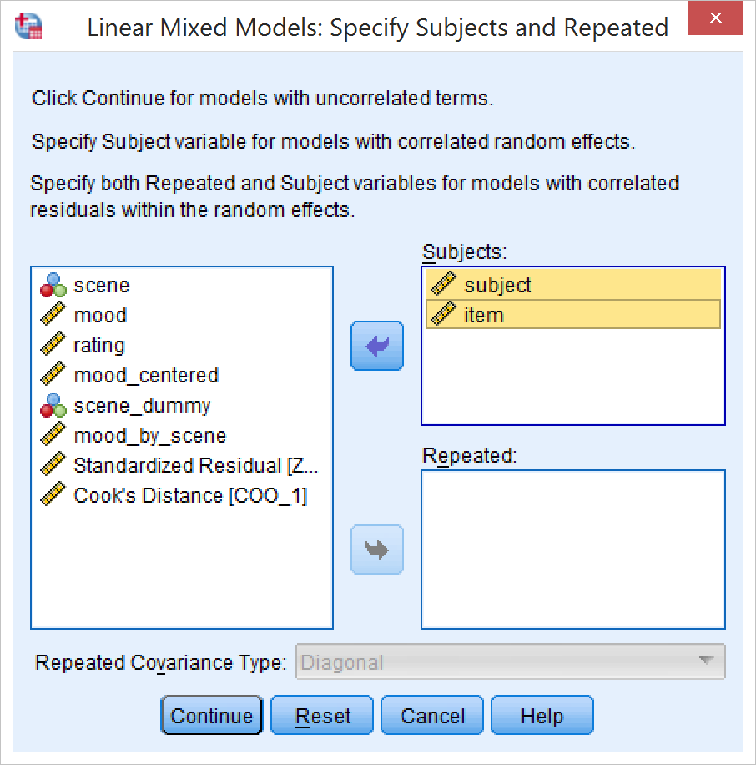
Linear mixed model
Analyze → Mixed → Linear
Enter “subject” and “item” as Subjects
Click Continue

Slide 16
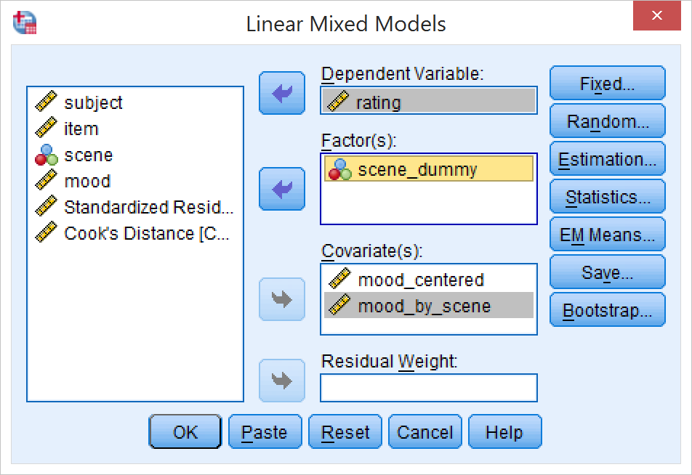
Linear mixed model
Enter “rating” as the dependent variable
Enter the recoded scene variable as a factor
Enter the centered mood variable as a covariate
Enter the interaction term as a covariate
Click “Fixed”

Slide 17
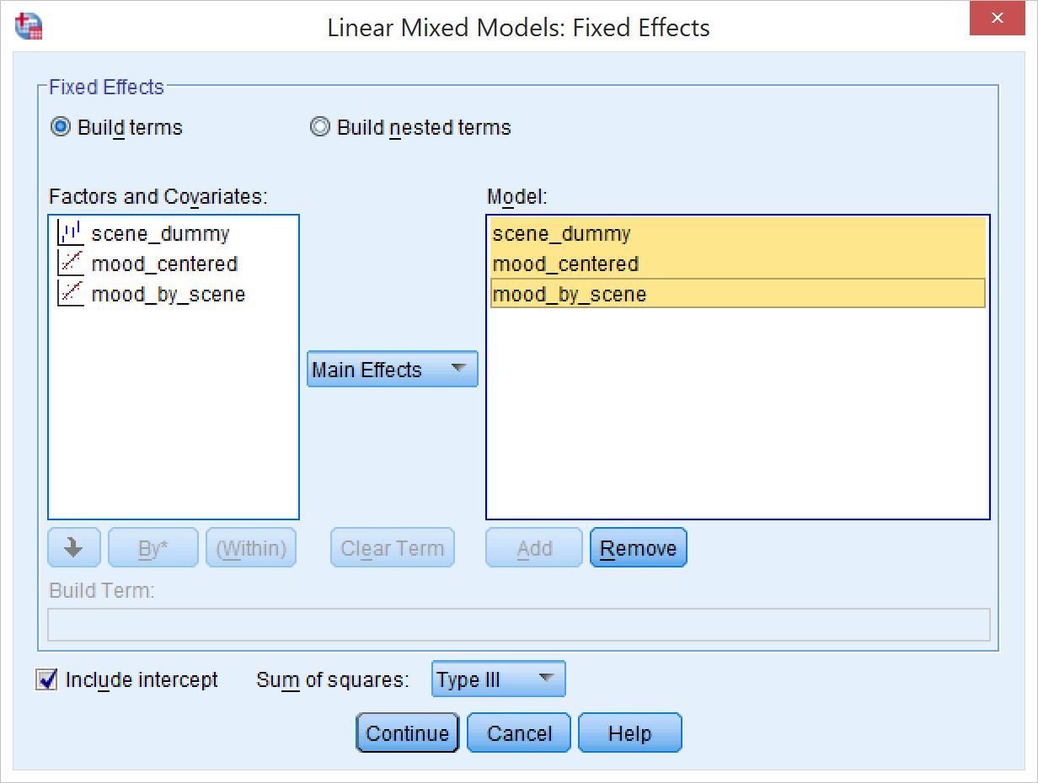
Linear mixed model
Select all three factors/covariates
In the drop-down menu, select “Main effects” (we coded the interaction term by hand, so to SPSS it looks like a main effect)
Click Add
Click Continue

Slide 18
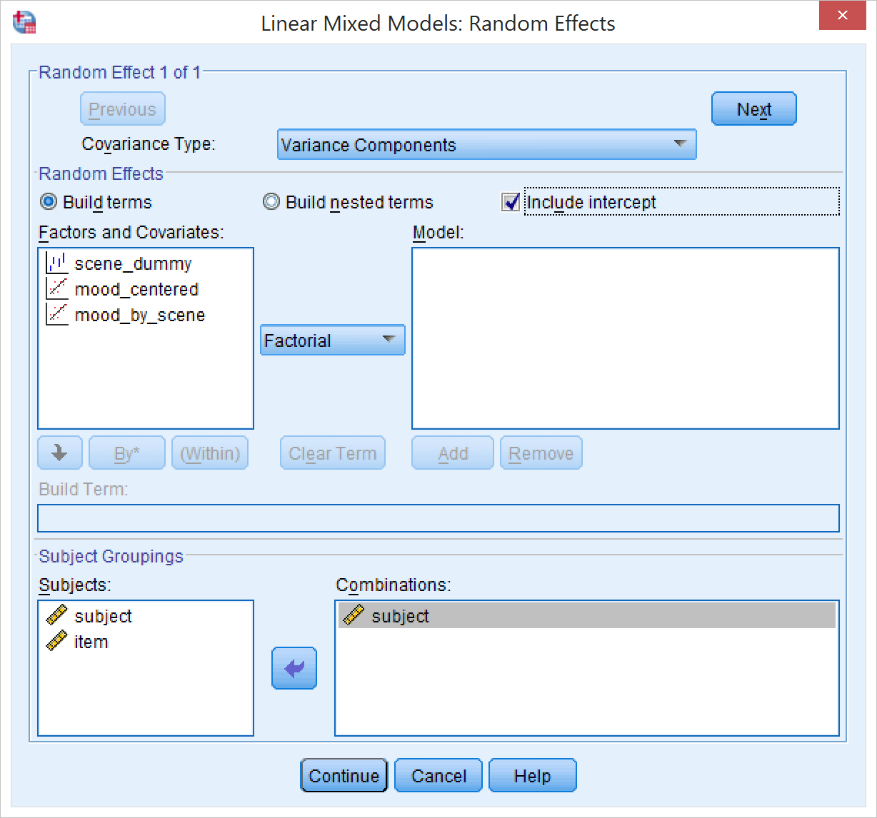
Linear mixed model
Click Random…
Define Subject random effects:
Enter “subject” into the “Combinations” filed
Select “Include intercept”
Click “Next”

Slide 19
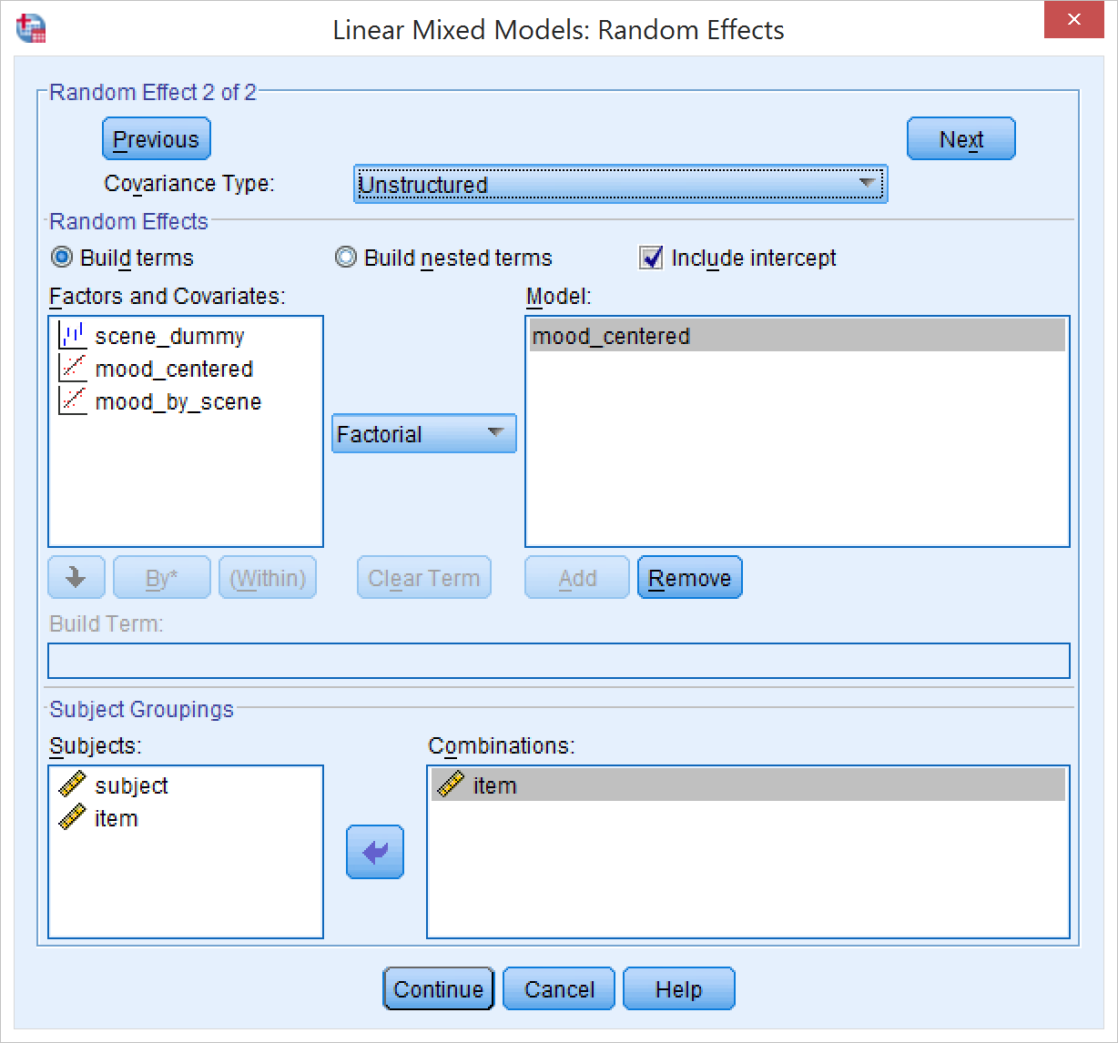
Linear mixed model
Click Random…
Define Item random effects:
Enter “item” into the “Combinations” filed
Select “Include intercept”
Select “mood_centered”
Click “Add”
In the Covariance Type dropdown menu, select “Unstructured”
Click “Next”
Note: you don’t need any random slopes for covariates in the assignment – the intercept is sufficient

Slide 20
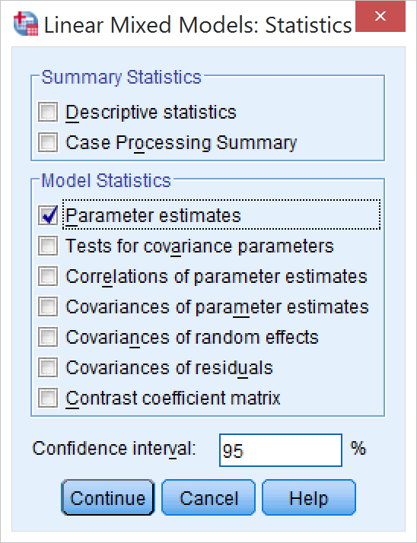
Linear mixed model
Final touches
Click “Statistics”
Select “Parameter estimates”
Click Continue

Slide 21
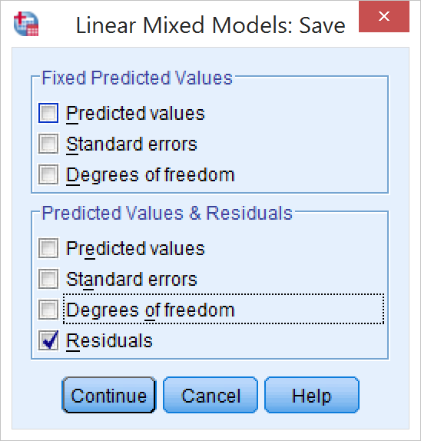
Linear mixed model
Click Save
Select Residuals
Click continue
Click OK to run the model

Slide 22
Linear mixed model results
Both scene and mood by scene are significant
Report the coefficient, t, and p values of the significant predictors

Slide 23
Linear mixed model residuals
Analyze → Descriptive Statistics → Explore
Same procedure as with the linear regression, just choose RESID_1 this time
Now the Shapiro-Wilk test is no longer significant

Slide 24
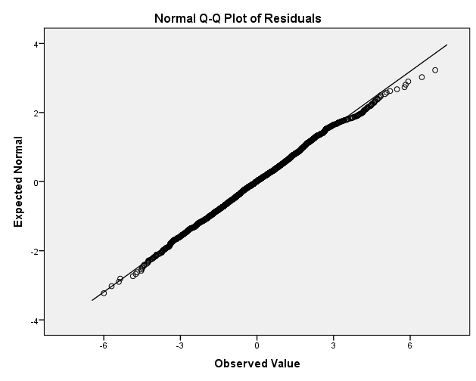
Linear mixed model residuals
The Quantile-Quantile plot also looks much better

Slide 25
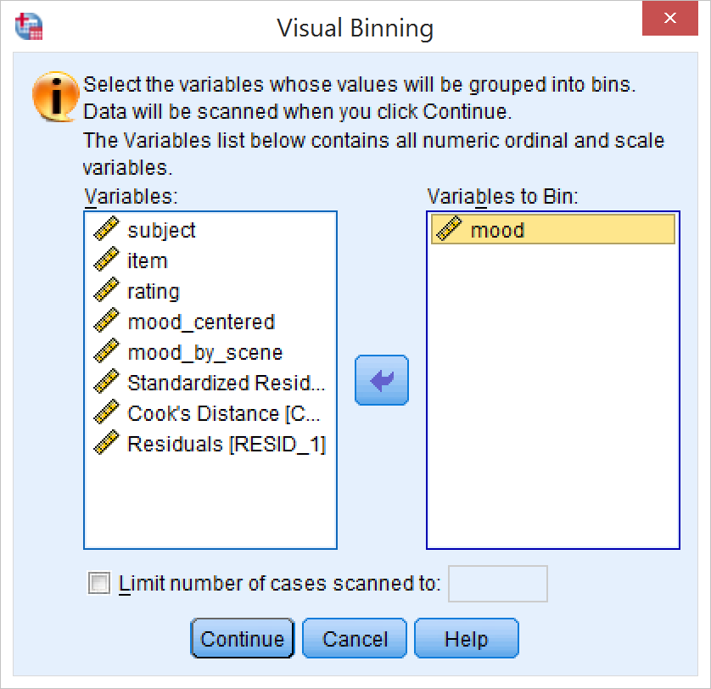
Plotting the mood by scene interaction
Need to split the mood variable into bins
Transform → Visual binning
Select “mood”
Click Continue

Slide 26
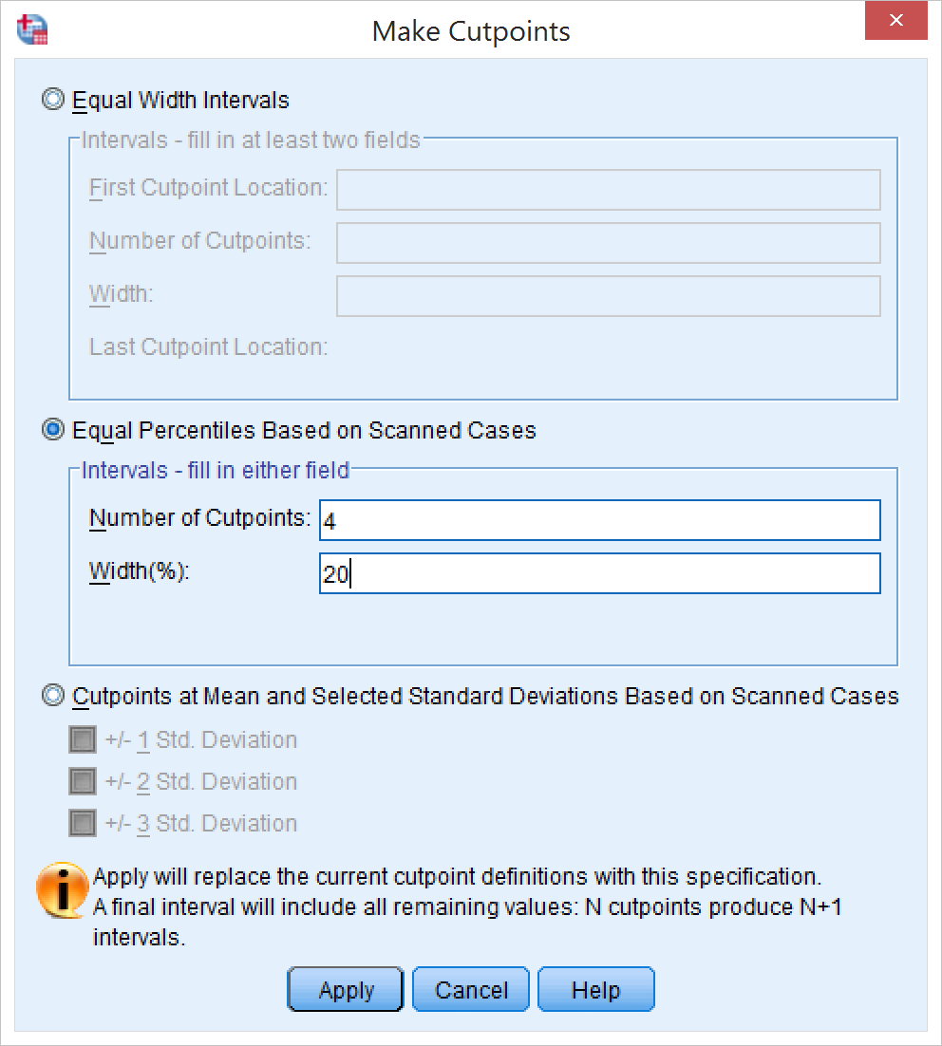
Plotting the mood by scene interaction
Click Make Cutpoints
Click “Equal Percentiles”
Enter 20 in the Width(%) field for 5 equally sized bins
Click Apply
Click OK

Slide 27
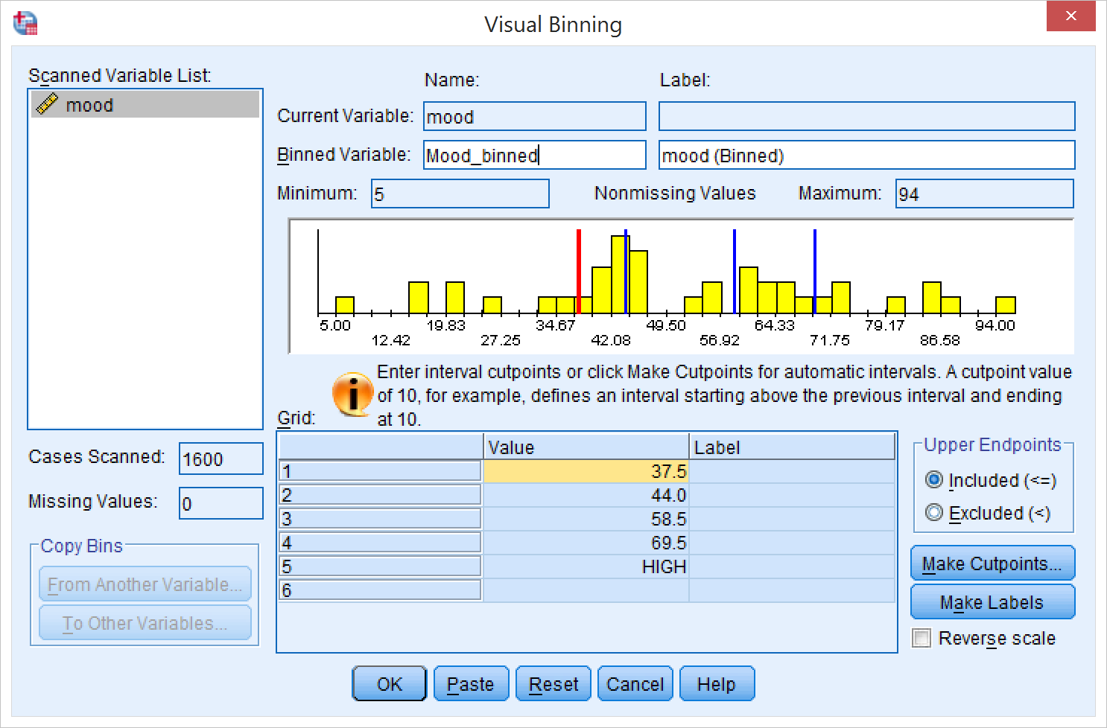
Binning mood
Choose a comprehensible name for the new binned variable and enter it in “Binned Variable”
Press OK

Slide 28
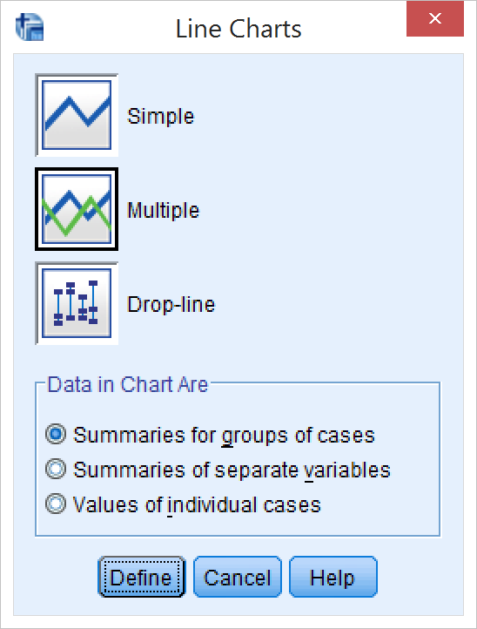
Making the plot
Graphs → Legacy Dialogs → Line
Select “Multiple” and “Summaries for groups of cases”
Click Define

Slide 29
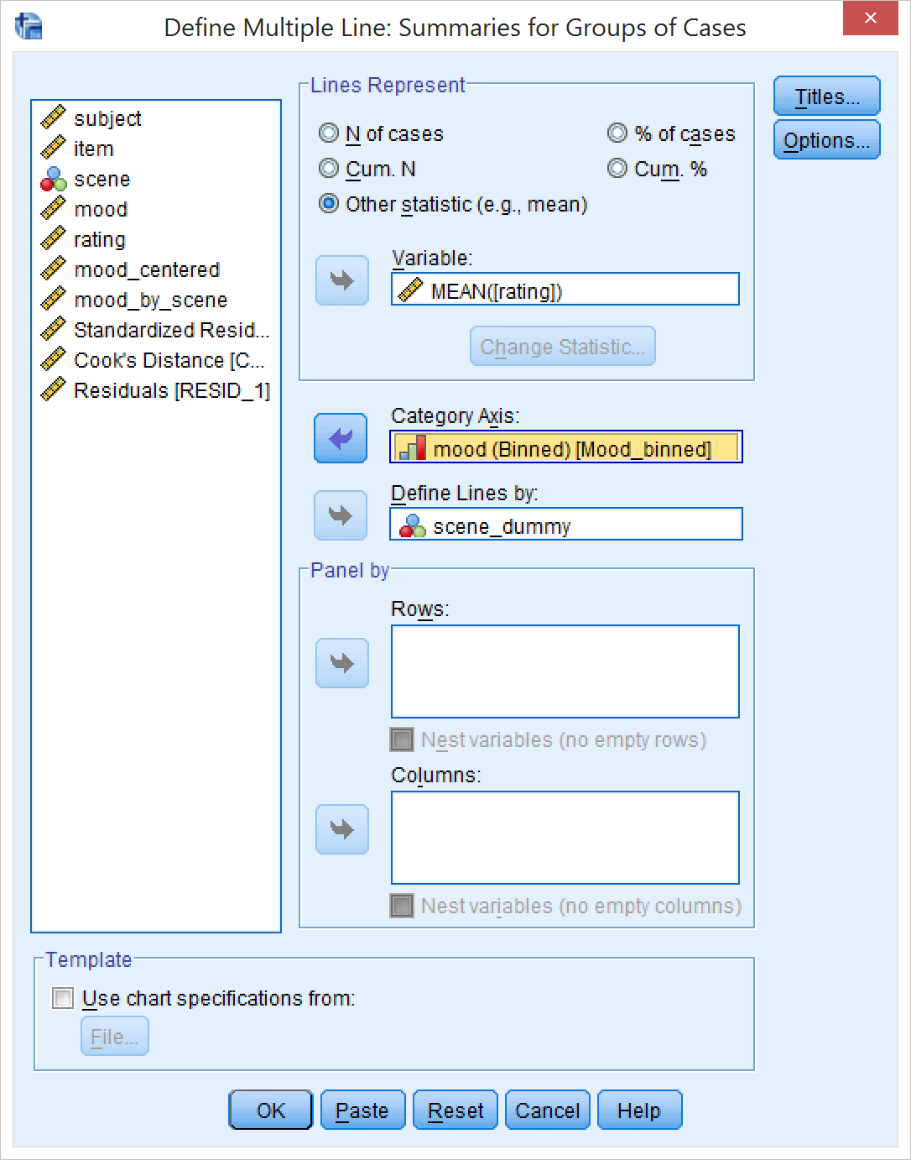
Line plot
Select “Other statistic”
Select rating as Variable
Select the binned mood variable as the Category Axis
Select “scene” as “Define lines by”
Click “Options”

Slide 30
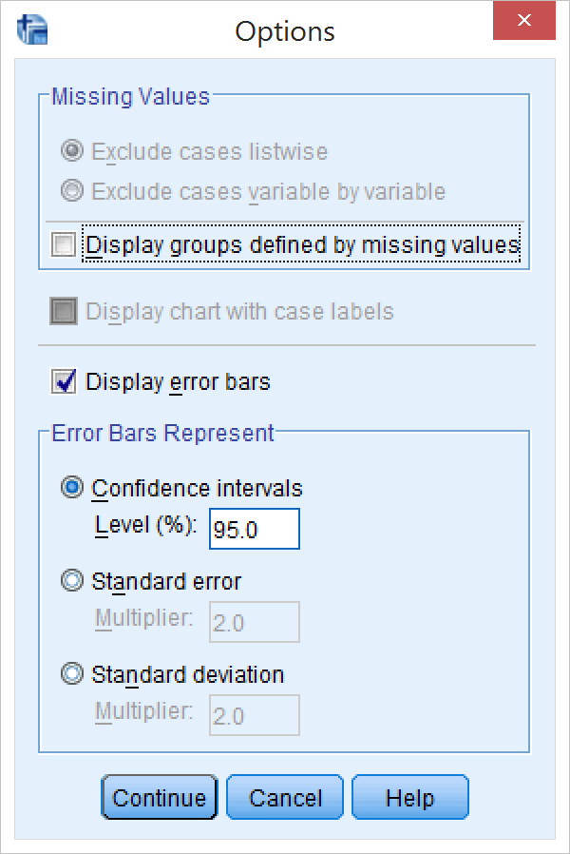
Line plot
Select “Display error bars”
Select 95% confidence intervals
Click Continue
Click OK

Slide 31
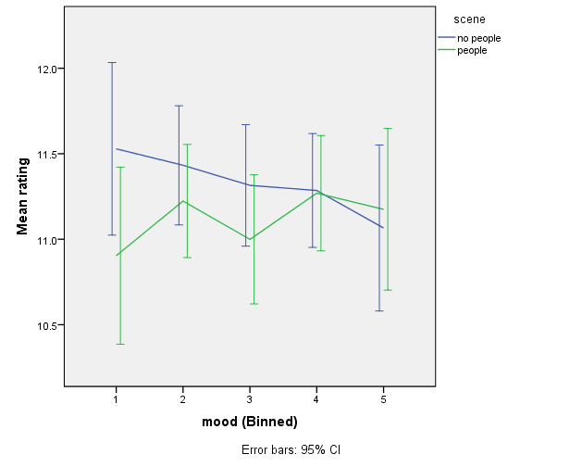
Line plot
There you go. Now just fix the axis labels and the legend

